Slide 1
Databases
Lecture 6

Slide 2
I. Normalization. 3NF, NFBC

Slide 3
Functional dependency
Definition of functional dependence (according to J. Date):
Let r be a relation, and X and Y be arbitrary subsets of the set of attributes of relation r. Then Y is functionally dependent on X, which is written symbolically as X → Y (read either "X functionally determines Y" or "X is an arrow of Y")
if and only if every value of the set X of the relation r is associated with exactly one value of the set Y of the relation r.

Slide 4
Functional dependency
Definition of functional dependence (according to J. Date):
In other words, if two tuples of a relation r coincide in the value X, they also coincide in the value Y (⬄ there are no two different tuples that have the same values in the X attribute and different values in the Y attribute).
The left part of the functional dependence record is called the determinant, the right part is the dependent part.

Slide 5
Relation between keys and functional dependencies
Heath’s theorem.
Let’s consider a relation R(A,B,C), where A,B,C are attributes. If R satisfies the functional dependency A -> B, then R is a union of R’s projections on attributes (A,B) and (A,C)

Slide 6
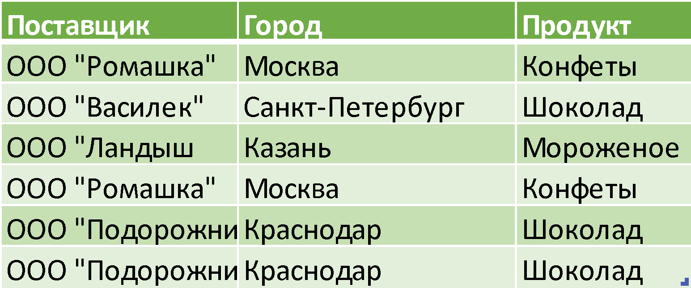
Functional dependency: Heath’s theorem
Distributor
City
Product

Slide 7
Functional dependency: Heath’s theorem
Distributor
City
Product
It is obvious that the data in the table above is redundant - information about suppliers, cities and products is duplicated in different rows

Slide 8
Functional dependency: Heath’s theorem
Distributor
City
Product
Let’s use Heath’s theorem

Slide 9
Functional dependency: Heath’s theorem
A = {Distributor}
B = {City}
C = {Product}
If A -> B, then R = {AB}⋈{AC}

Slide 10
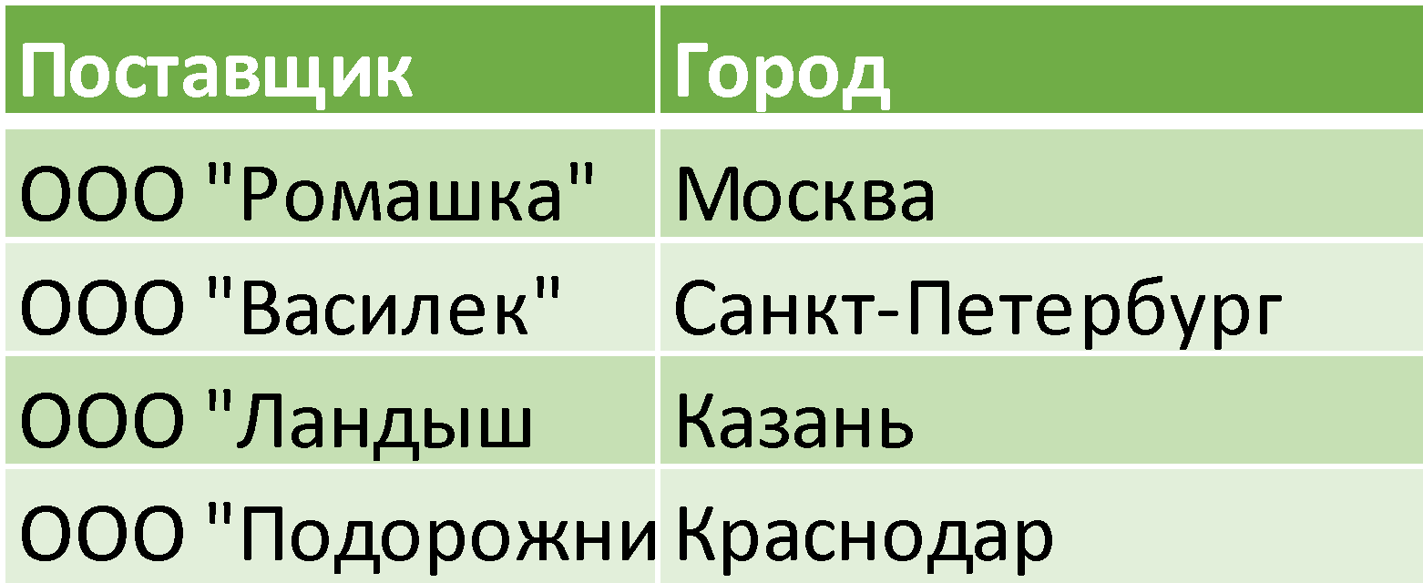
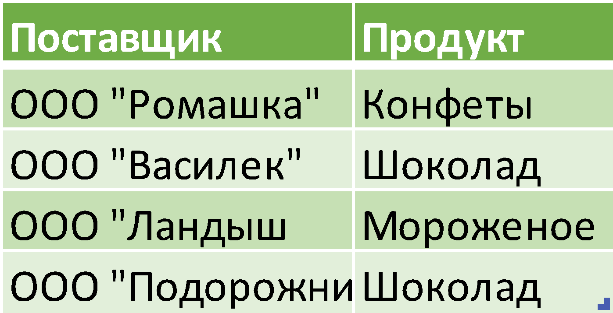
FD: Heath’s theorem

Slide 11
3NF
A relation is in the third normal form if and only if it is in second normal form and no non-key attribute is transitively dependent on its primary key (the definition assumes there is only one candidate key, which is also the relation's primary key)
Informal definition: A relation is in 3NF if and only if each tuple consists of a primary key value, and a set of mutually independent attributes

Slide 12
3NF: transitive dependency
If functional dependencies X -> Y, Y -> Z exist for attributes X, Y, Z of the relation R, then Z has a transitive dependency on attribute X via attribute Y (and X is not functionally dependent on Y or Z).

Slide 13
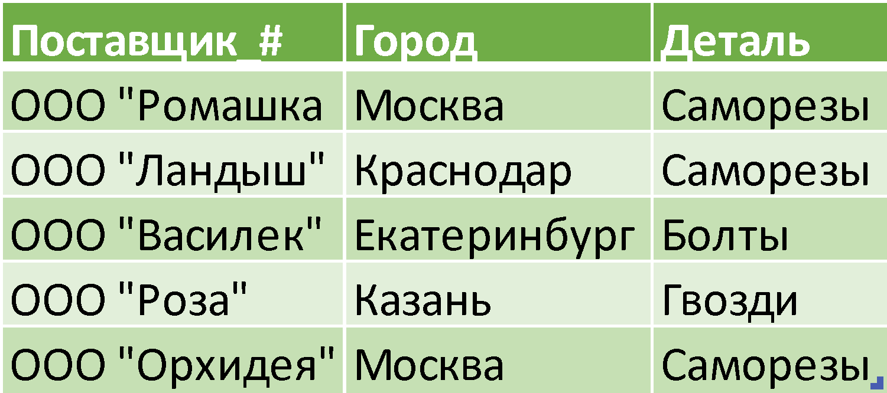
3NF: example
X - {Distributor_#} - primary key
Y - {City}
Z - {Piece}
{Distributor_#} -> {City}, {City}->{Piece}
{Distributor_#} ⇷ {City}, {City}⇷{Piece}
Distributor_#
City
Piece

Slide 14
3NF: example
X - {Distributor_#} - primary key
Y - {City}
Z - {Piece}
{Distributor_#} -> {City}, {City}->{Piece}
{Distributor_#} ⇷ {City}, {City}⇷{Piece}
Let’s try to reduce FD
{Distributor_#} -> {Piece}
R = {Distributor_#, Piece} ⋈{Distributor_#, City}
Distributor_#
City
Piece

Slide 15
3NF: example
X - {Distributor_#} - primary key
Y - {City}
Z - {Piece}
{Distributor_#} -> {City}, {City}->{Piece}
{Distributor_#} ⇷ {City}, {City}⇷{Piece}
Let’s try to reduce FD
{Distributor_#} -> {Piece}
R = {Distributor_#, Piece} ⋈ {Distributor_#, City}
IN GENERAL, THIS IS INCORRECT!
Distributor_#
City
Piece

Slide 16
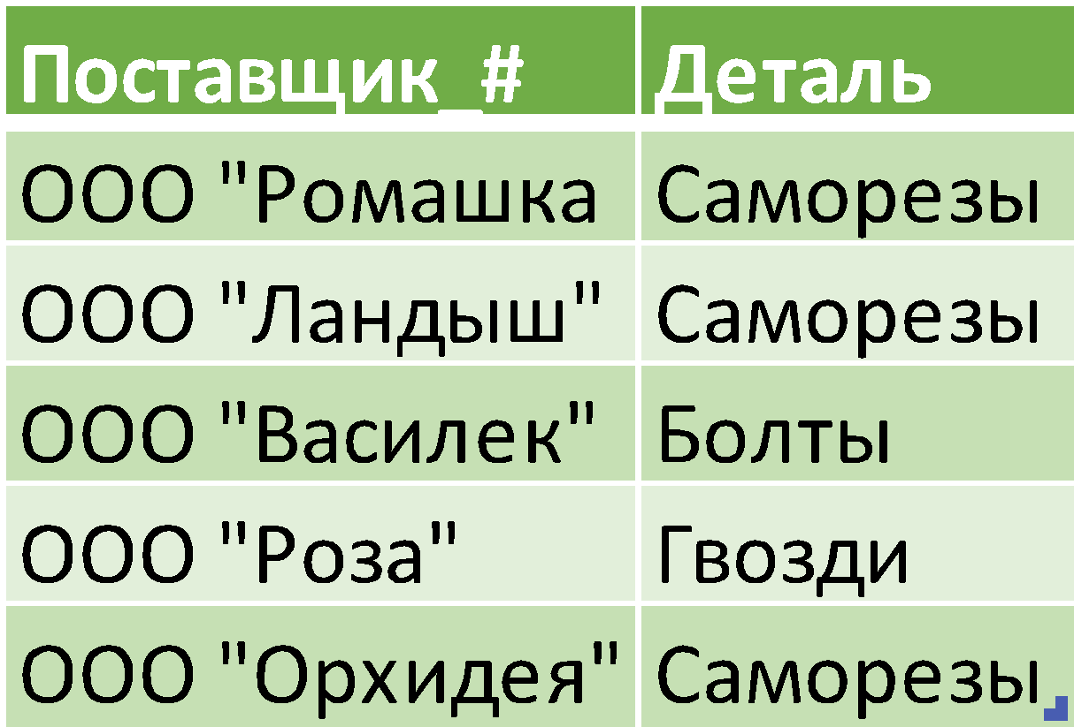
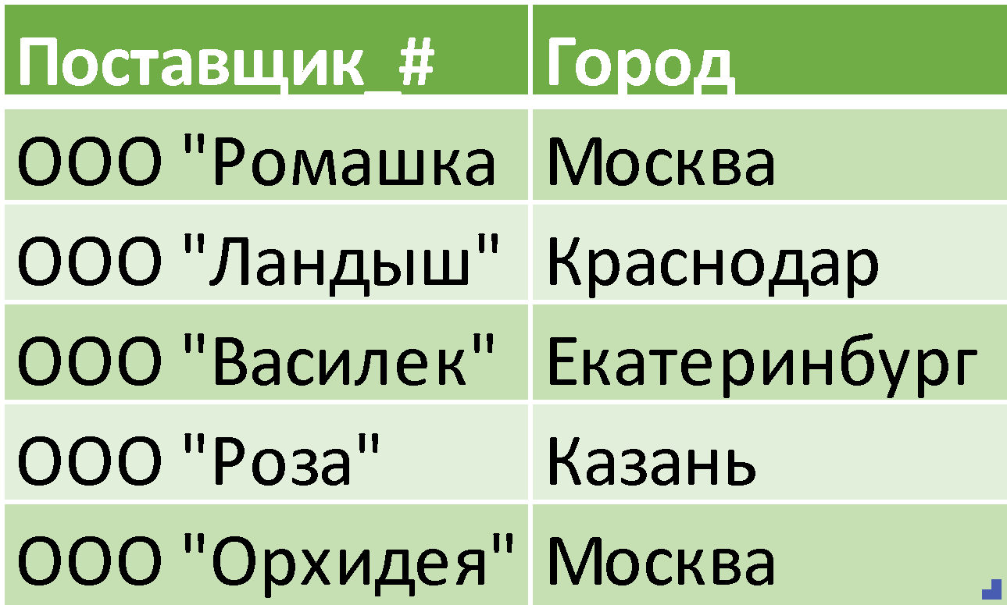
3NF: example
We’ve lost FD {City} -> {Piece}

Slide 17
3NF: example
X - {Distributor_#} - primary key
Y - {City}
Z - {Piece}
{Distributor_#} -> {City}, {City}->{Piece}
{Distributor_#} ⇷ {City}, {City}⇷{Piece}
Let’s try to reduce FD
{Distributor_#} -> {Piece}
R = {Distributor_#, City} ⋈ {City, Piece}
Distributor_#
City
Piece

Slide 18
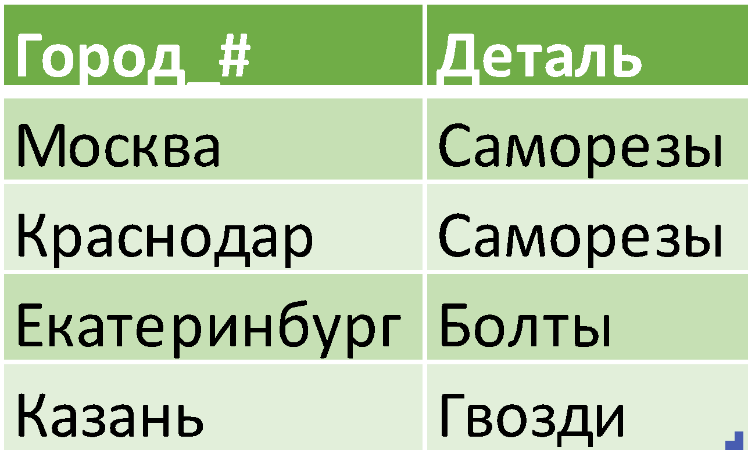
3NF: example

Slide 19
BCNF
BCNF is used under the following conditions (according to K. Date):
a relation has two (or more) candidate keys
these potential keys are composite
two or more candidate keys overlap (i.e. have at least one attribute in common)
In practice, a set of such conditions does not occur often, so they are limited to 2NF

Slide 20
BCNF
Definition:
A relation is in BCNF if and only if each of its nontrivial and left irreducible functional dependencies has some potential key as its determinant.
Trivial FD - FD between composite primary key and its attributes
Left irreducibility = minimal FD
Informal definition:
A relation variable is in BCNF if and only if the determinants of all its RFs are potential keys

Slide 21
BCNF: example
Let’s consider the relation {Student, Subject, Professor}
Let it satisfy the following restrictions
Every student study the particular subject with only one professor
Every professor teaches only one subject, but many professors teach the same subject
Then
{Student, Subject} -> {Professor}
{Professor} -> {Subject}

Slide 22
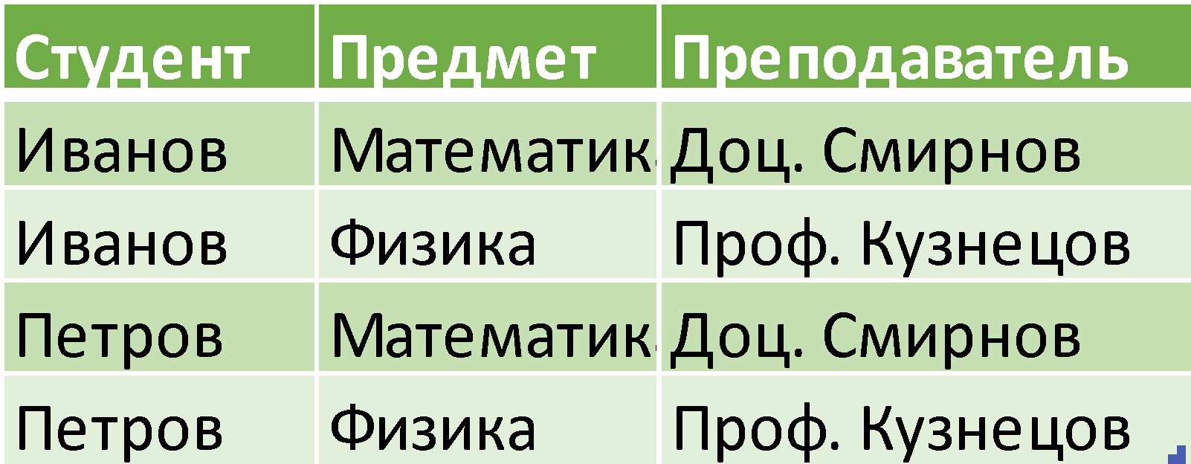
BCNF: example
Student
Subject
Professor
Potential keys:
{Student, Subject}
{Student, Professor}

Slide 23
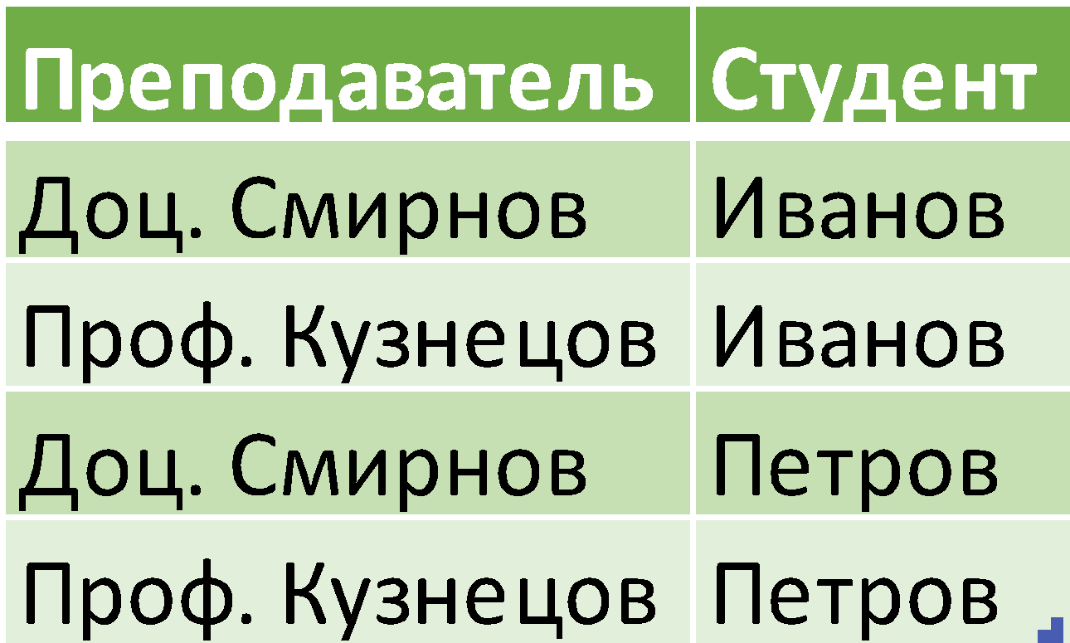
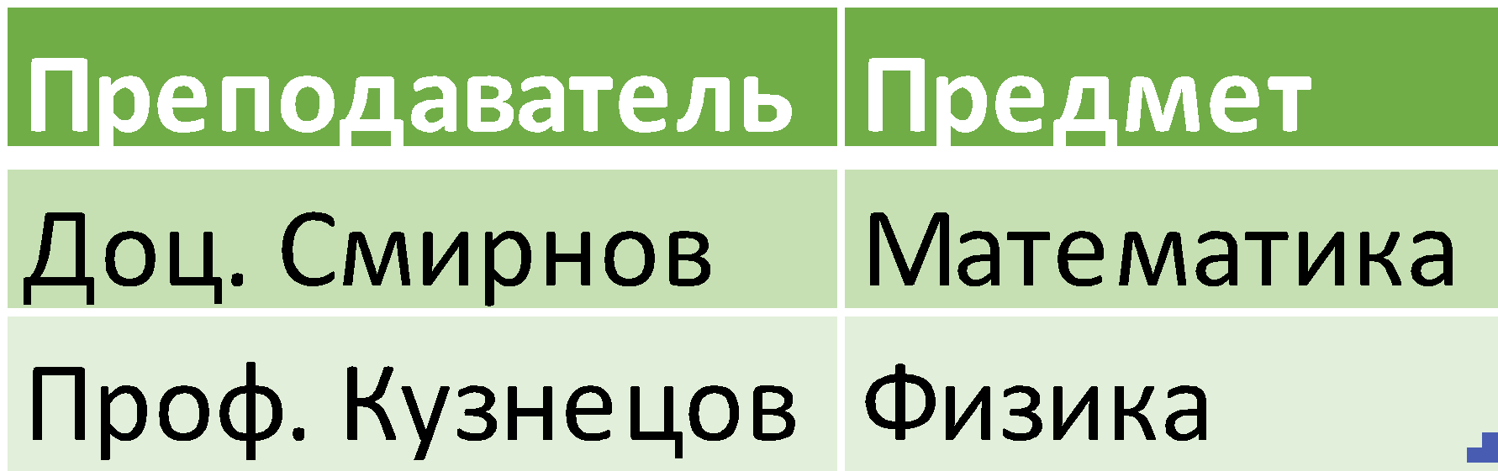
BCNF
Student
Subject
Professor
Professor
Student
Professor
Subject

Slide 24
BCNF: example
We still have a problem.
Decomposition of the original relation on projections ST and TJ let us to exclude one types of anomalies, but add another types.
Initial FD {Student, Subject} -> {Professor} cannot be derived from the single FD {Professor} -> {Subject} that still presents in the data

Slide 25
II. Versioning

Slide 26
Versioning
Versioning is a change management technique that allows you to store, track and manage different versions of data over time
Why do we need that:
Historical storage: Versioning allows you to store historical versions of records, allowing you to analyze trends and restore previous states of data
Audit and Reporting: Supports audit requirements by allowing you to track who made what changes to data, when and what
Conflict management: In a multi-user environment, helps resolve conflicts that arise when different users change the same data at the same time.

Slide 27
Versioning
Conventionally, versioning can be divided into built-in and manual
Versioning
Built-in
Manual
Using internal DBMS tools or extensions
By creating additional structures in the data schema that store the history of changes to a particular record

Slide 28
«Manual» versioning
One of the manual methods – Slowly Changing Dimensions (term by – Ralph Kimball, Margy Ross, The Data Warehouse Toolkit)
The term comes from the concept of data warehouse design developed by Ralph Kimball (an alternative concept is William Inmon)

Slide 29
«Manual» versioning
Relationships in the repository are conventionally divided into fact tables and dimension tables.
Fact tables record data about the facts of the company’s “economic life” (sales, deliveries, acceptance of consignments, etc.)
Dimension tables record descriptive information about objects or events. Each row in a dimension table represents one entity or one dimension variant. Measurement tables are designed to answer the questions of who, what, where, when, how and why “committed” or participated in a particular fact entered in the fact table)

Slide 30
«Manual» versioning
Since dimension tables can change at different intervals, and there is also a need to store change history or early data, the technique/concept of Slowly Changing Dimensions was proposed

Slide 31
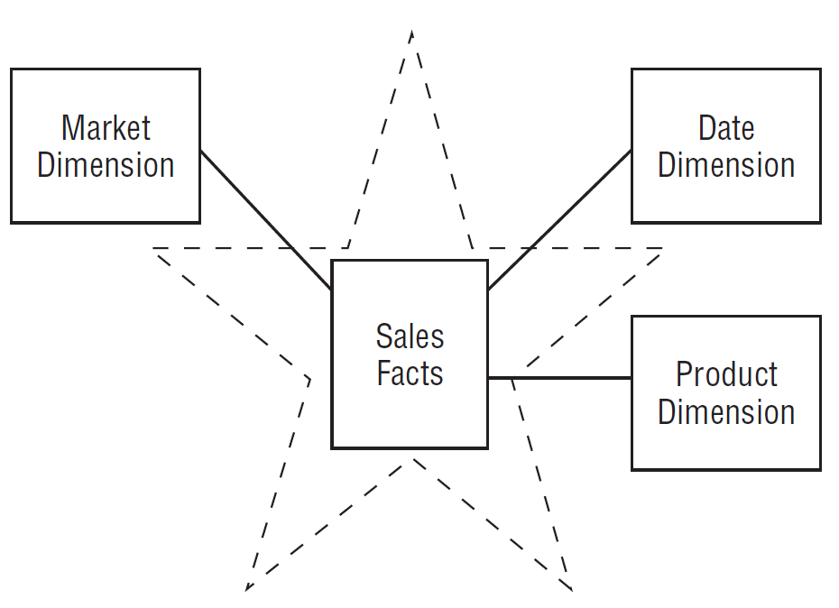
«Manual» versioning - dimensions
*Ralph Kimball, Margy Ross, The Data Warehouse Toolkit, 2013

Slide 32
SCD – Slowly Changing Dimensions
SCD
Type 0 – saving the original
Attribute values do not change
Type 1 - Overwrite
The data is completely replaced with new ones
Type 2 - Adding a new line
The old entry is saved, the new one is simply added in the next line
Type 3 – Adding a new attribute
The old record is saved, new attributes are added that store the previous value
Type 4 – Adding a new relationship
The old record is overwritten, changes are stored in a separate table

Slide 33
SCD – Slowly Changing Dimensions
Kimball identifies two more types of SCD (5 and 6)
These types are combinations of the previous ones, and also entail the need to perform additional operations when adding data
For versioning data in a “classic” DBMS they are less important
In practice, types 2-4 are most often used (type 2 is most often used)

Slide 34
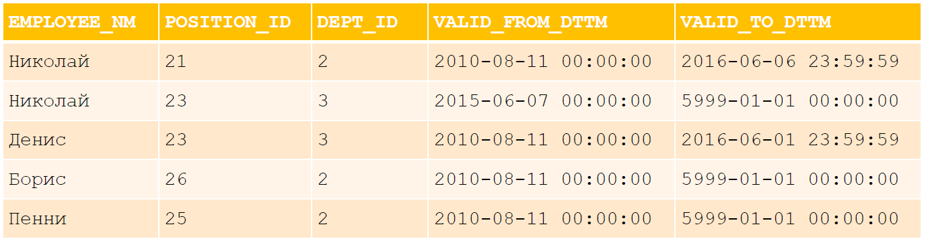
SCD 2: example
Here: creating a new record in the table for each version of the data, adding fields for the start date and end date of the version's existence period

Slide 35
SCD 2: example
The valid_from_dttm and valid_to_dttm fields generally do not use NULL values. Instead of NULL, some constant is used, for example, ‘59 99 01 01 00:00:00’ for valid_to_dttm , as in the example. This approach simplifies writing conditions:
WHERE day_dt BETWEEN valid_from_dttm AND valid_to_dttm
instead of
WHERE day_dt >= valid_from_dttm
AND day_dt <= valid_to_dttm
OR valid _to_dttm IS NULL)

Slide 36
SCD 2: characteristics
Advantages:
Stores a complete and unlimited version history
Convenient and easy access to data of the required period
Disadvantages:
Provokes redundancy or the creation of additional tables to store changeable attributes

Slide 37
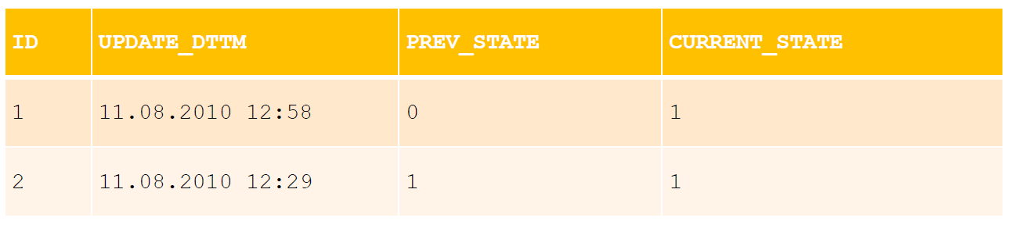
SCD 3: example
Here: The record itself contains additional fields for previous attribute values. When new data is received, the old data is overwritten with the current values.

Slide 38
SCD 3: characteristics
Advantages:
Small amount of data
Easy and quick access to history
Disadvantages:
Limited history

Slide 39
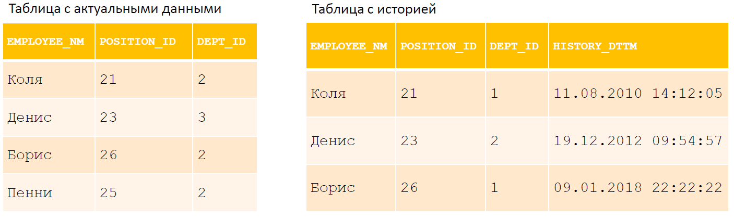
SCD 4: example

Slide 40
SCD 4: characteristics
Advantages:
Quick work with current versions
Disadvantages:
Splitting a single entity into different tables

Slide 41
III. TCL, ACID, isolation

Slide 42
Groups of SQL operators
SQL statements
Data Definition Language (DDL)
Data Manipulation Language (DML)
Data Control Language (DCL)
Transaction Control Language (TCL)
CREATE
ALTER
TRUNCATE
DROP
INSERT
SELECT
UPDATE
DELETE
GRANT
REVOKE
COMMIT
ROLLBACK

Slide 43
TRANSACTION
A transaction is a group of sequential operations with a database, which is a logical unit of work with data, guaranteed to transfer the database from one consistent state to another.

Slide 44
Transaction
Transactions ensure the integrity of the database under the following conditions:
Parallel data processing
Physical disk failures
Emergency power failure
And others...
Relational DBMS transactions necessarily have four key properties. They are usually abbreviated to ACID.

Slide 45
CAP-theorem
It is impossible for any distributed computing implementation to provide more than two of the following properties:
Data consistency (Consistency) – in all computing nodes at one point in time, data does not contradict each other;
Data availability (Availability) – any request to a distributed system ends with a correct response, but without a guarantee that the responses of all system nodes match;
Partition tolerance – splitting a distributed system into several isolated sections does not lead to incorrect response from each section.
*Maximizing Consistency and Availability generates ACID transaction properties for RDBMS

Slide 46
ACID
Transactions must satisfy the following requirements:
Atomic
Either all sub-operations have been completed or none
Consistent
Each successful transaction records only valid results
Isolated
Parallel transactions do not affect each other's results
Durable
Regardless of system failures, the results of successful transactions will be stored in the system

Slide 47
ACID: Atomic
No transaction will be partially recorded in the system
Either all sub-operations have been performed, or none
In practice, simultaneous and atomic execution of transactions is not possible
In practice, "atomicity" is implemented using "rollback" (rollback)
During the rollback process, all operations that have already been performed are canceled

Slide 48
ACID: Consistent
Once the transaction is complete, all data should remain in a consistent state. When executing a transaction, all rules of the relational DBMS must be followed:
Constraint compliance checks (domains, unique indexes, foreign keys, checks, rules, etc.)
Index update
Executing Triggers
And others
But: consistency is not required during the operation (due to atomicity, intermediate inconsistency remains hidden)

Slide 49
ACID: Isolated
Changes to data made within a transaction must be isolated from all changes made in other transactions until the transaction is committed. There are different isolation levels to achieve a compromise between the degree of parallelization of work with the database and the strictness of the implementation of the principle of consistency:
The higher the isolation level, the higher the degree of data consistency;
The higher the isolation level, the lower the degree of parallelization and the lower the degree of data availability.
In real databases, complete isolation is not supported!

Slide 50
ACID: Durable
If a transaction has been made, its result must be stored in the system, despite the system failure. That is, if the user has received confirmation of the success of the transaction, the safety of the results is guaranteed
If a transaction was not completed, its result may be completely canceled due to a system failure.

Slide 51
TCL (TRANSACTION CONTROL LANGUAGE)
COMMIT
Applies the transaction, i.e. saves the changes made during the execution of the transaction
ROLLBACK
Rolls back all changes made during the execution of the transaction
SAVEPOINT
Creates a so-called breakpoint

Slide 52
BREAKPOINT
A breakpoint is an intermediate section in a transaction to
which you can roll back if necessary.
Allows you to split a transaction into parts
Allows you to implement "nested" transactions

Slide 53
Syntax
BEGIN TRANSACTION transaction_mode [,
ISOLATION LEVEL { SERIALIZABLE | REPEATABLE READ | READ
COMMITTED | READ UNCOMMITTED }
READ WRITE | READ ONLY
[ NOT ] DEFERRABLE
BEGIN / START
COMMIT
ROLLBACK
SAVEPOINT name
ROLLBACK TO SAVEPOINT name
RELEASE SAVEPOINT name

Slide 54
Example
BEGIN TRANSACTION ISOLATION LEVEL READ COMMITTED;
INSERT
INTO table1 VALUES (1);
SAVEPOINT my_savepoint
INSERT INTO table1 VALUES (2);
ROLLBACK TO SAVEPOINT my_savepoint
INSERT INTO table1 VALUES (3);
COMMIT

Slide 55
Isolation problems
Lost update
Changing one block of data by multiple transactions
“Dirty” reading
Reading data modified by a rolled back transaction
Not repeating reading
Repeated reading of changed data by the same transaction
Reading phantoms
If a transaction repeats a query with some condition, and another transaction adds or removes rows that satisfy that condition, the resulting row set will be different

Slide 56
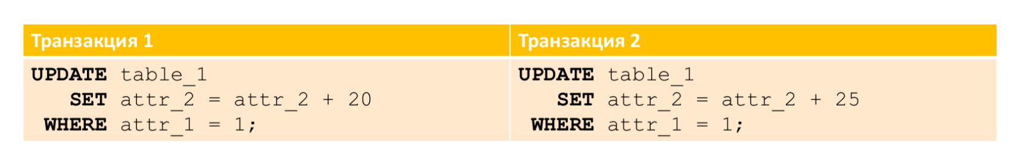
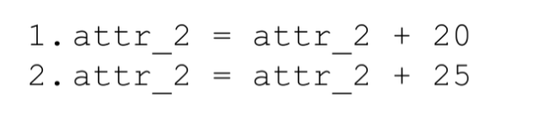
LOST UPDATE
The result is not unambiguously defined

Slide 57
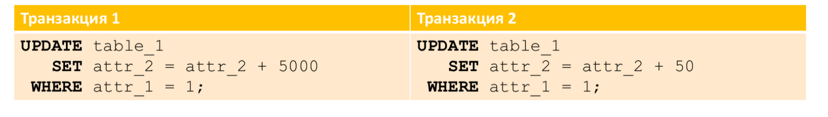
LOST UPDATE
You top up your card for 5000 rubles
Someone transfers you 50 rubles
The total amount on your account is unknown

Slide 58
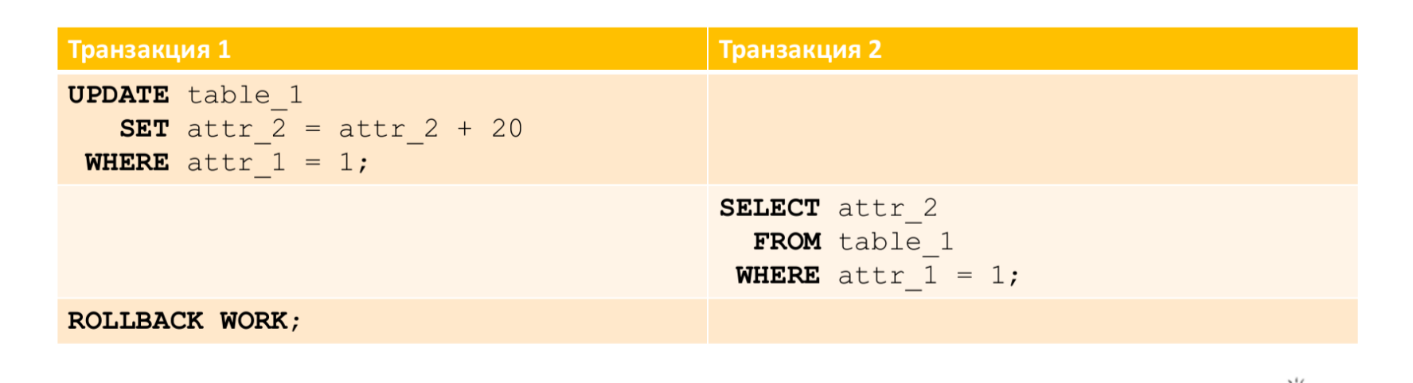
"DIRTY" READING
You are paying for an expensive purchase from a relative's account
Your relative checks the remainder -> falls into a stupor
………………………………….
The write-off does not pass, the transaction is rolled back, but the relative
is already in shock

Slide 59
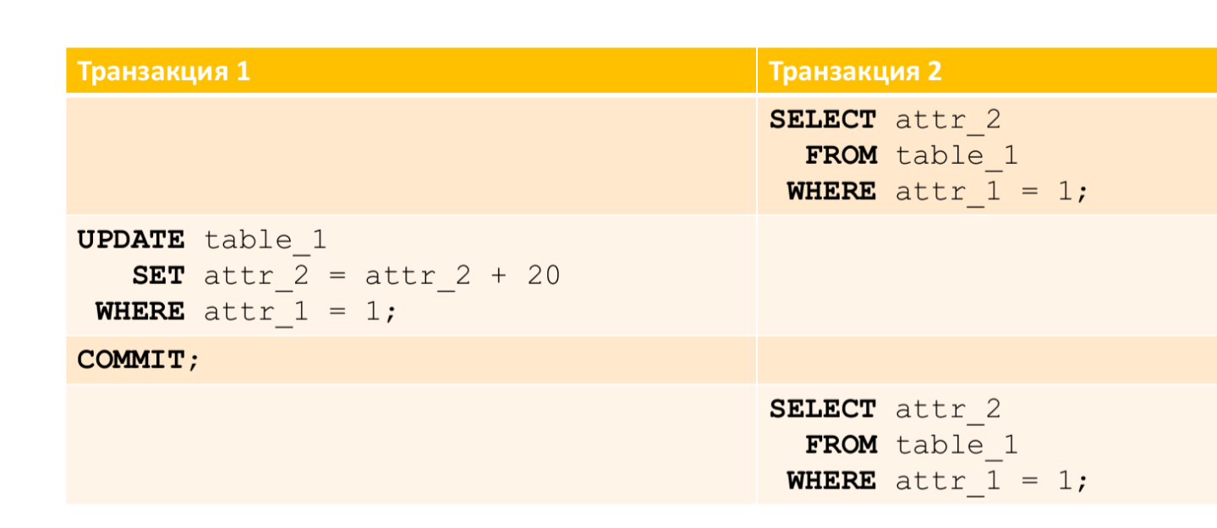
NON-REPEATING READING
You have created a shopping cart on the website and click on the "Pay" button
The cost of goods on the site is increasing
A larger amount is debited from the card than you expected

Slide 60
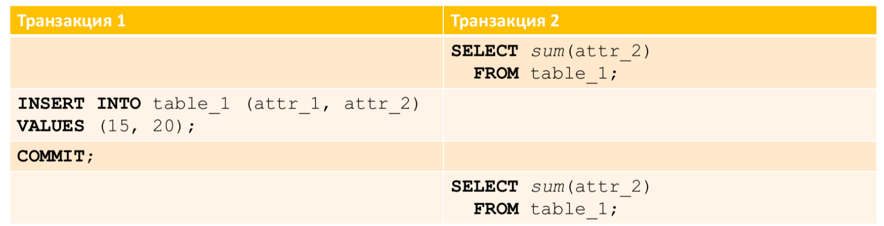
READING PHANTOMS
The boss asked you to make a general spending report based on the results of the current month and in the context of the weeks of the same month
You calculate the total amount of transactions per month
A new write-off is taking place
You calculate the amount of transactions in the context of weeks → take into account a new transaction –> the amounts do not beat

Slide 61
TRANSACTION ISOLATION LEVELS
Read uncommitted (read uncommitted data)
Read committed (reading fixed data)
Repeatable read (read repeatability)
Serializable (orderability)

Slide 62
READ UNCOMMITTED
First level of isolation
Ensures no lost updates
The final value is the result of each transaction
It is possible to read unfixed changes
Data is blocked for the time of making changes
There is no lock during data reading

Slide 63
Read uncommitted
In PostgreSQL, you can query for any of the four transaction isolation levels, but only three different levels are implemented internally, meaning the Read Uncommitted mode in PostgreSQL acts like Read Committed. The reason for this is that it is the only way to map standard isolation levels to PostgreSQL's Multi-Version Concurrency Control (MVCC) architecture.

Slide 64
READ COMMITTED
Second level of isolation
Used in most DBMS
Protection against dirty reading
In the process of execution, one of the transactions
completes successfully, then the rest work with the changed data
Implementation of IRL at the discretion of DBMS developers:
Blocking of readable and modifiable data
Saving multiple versions of lines being modified in parallel

Slide 65
Repeatable read
The reading transaction ignores changes to data that were previously read to it
No transaction can modify data read by the current transaction until the read is complete
Saves from the effect of non-repeating reading
This level differs from Read Committed in that a request in a transaction at this level sees a snapshot of the data at the start of the first statement in the transaction (not counting transaction control commands), and not the start of the current statement. Thus, for example, successive SELECT commands in the same transaction see the same data; they do not see changes made and committed by other transactions after their current transaction began.

Slide 66
SERIALIZABLE
The fourth (highest) level of isolation
Transactions are completely isolated from each other
Parallel transactions do not seem to exist at all
Transactions are not subject to the effect of "phantom reading"

Slide 67
Serializable
This level models the sequential execution of all committed transactions, as if the transactions were executed one after the other, sequentially rather than in parallel. In fact, this isolation mode works in the same way as Repeatable Read, only it additionally monitors for conditions under which the result of serializable transactions executed in parallel may not be consistent with the result of the same transactions executed in turn.

Slide 68
TRANSACTION ISOLATION LEVELS
Isolation level | Lost update | “Dirty” reading | Non-repeating reading | Reading phantoms
Read uncommited | + | - | - | -
Read committed | + | + | - | -
Repeatable read | + | + | + | -
Serializable | + | + | + | +
“+” – prevented
“-” – not prevented

Slide 69
TRANSACTION ISOLATION LEVELS Postgres
Isolation level | “Dirty” reading | Non-repeating reading | Reading phantoms | Serialization anomalies
Read uncommited | Possible, but not in Postgres | Possible | Possible | Possible
Read committed | Impossible | Possible | Possible | Possible
Repeatable read | Impossible | Impossible | Possible, but not in Postgres | Possible
Serializable | Impossible | Impossible | Impossible | Impossible
“Serialization anomaly” - the result of a successful commit of a group of transactions turns out to be inconsistent under all possible options for executing these transactions in turn (that is, unlike a lost update, there will be no result at all)

